Slide 1
Smartphone security
Lecture 8

Slide 2
Contents:
1. Appstore security.
2. App ecosystem.
3. STRIDE threat analysis.
4. App review.
5. Reputation mechanism.
6. App revocation (kill-switch).
7. Device security.
8. Jails (or walled gardens).
9. Sandboxing and capabilities.
10. Controlled software distribution.
11. Remote application removal.
12. Backup and recovery.
13. Extra authentication and encryption options.

Slide 3
Statistics
Most of the mobile malware was hosted in 3rd party app stores and the app categories that most mobile malware was found were Lifestyle (27%) and Music & Audio (20%)
Growth in mobile phishing attacks
46% of businesses feel vulnerable for the exposure to risks coming from mobile device loss
In January 2018, information collected by the mobile fitness tracking and sharing app Strava has highlighted the locations of secret Russia, UK, and US military bases in Syria and Afghanistan
Sungy Mobile Ltd., one of the world’s leading mobile application developers, leaked the details on 50 million consumers due to a misconfigured backup database
3% of the T-mobile customers’ records (2,3 million individuals) were breached in August 2018
More than 20.000 installations of mobile ransomware Trojans were detected in the 2018

Slide 4
Security risks and opportunities for smartphone users
Data leakage
Improper decommissioning
Unintentional data disclosure
Phishing
Spyware
Network spoofing attacks
Surveillance
Diallerware
Financial malware
Network congestion

Slide 5
Assets
· Personal data
· Corporate intellectual property
· Classified information
· Financial assets
· Device and service availability and functionality
· Personal and political reputation

Slide 6
Location data is often included in image files. Users, by giving an app access to the image files, may be unintentionally disclosing their whereabouts. An interesting demonstration of the extent of information disclosed is provided by the web site https://www.pic2map.com which (for awareness raising purposes) collates data disclosed via GPS data embedded in images.
In a recent study, mobile phones were bought second-hand on eBay and, out of the 26 business smartphones, 4 contained information from which the owner could be identified while 7 contained enough data to identify the owner's employer. The research team managed to trace one smartphone to a senior sales director of a corporation, recovering call history, address book entries, diary, emails, etc
The app Jigsaw is able to recognise user activities based on an analysis of microphone, GPS and accelerometer for patterns characteristic of routine activities. For example, the jolts produced when the user is walking depend on whether the phone is in a trouser or jacket pocket, so the software can recognise both patterns.

Slide 7
Specific risks
Risks from the use of remote or cloud backup services
Attacks on online services used by smartphones, such as injection attacks
Attacks on authentication systems
Attacks on or via online services
Attacks on web browsers
Risks which exclusively affect a single smartphone model

Slide 8
Analysis of potential situations
Smartphones, being both valuable and pocket-sized, are likely to be stolen or lost
Smartphones often contain valuable information such as credit card data, bank account numbers, passwords, contact data, and so on
Business phones often contain corporate emails and documents and may contain sensitive data
Most apps have privacy settings for controlling how and when location data is transmitted, but many users are unaware (or do not recall) that the data is being transmitted, let alone know of the existence of the privacy setting to prevent this

Slide 9
Analysis of potential situations
Mobile devices are being recycled
Smartphones contain multiple sensors such as a microphone, camera, accelerometer and GPS. This, combined with the possibility of installing third- party software and the fact that a smartphone is closely associated with an individual, makes it a useful spying tool
Financial malware may be a key-logger collecting credit card numbers, or it may be more sophisticated and intercept SMS authentication codes to attack online banking applications.
Another strategy is for an attacker to submit an app to an app-store, impersonating a real banking app. If
users download and use the app, the attacker can mount a man-in-the-middle attack on banking transactions

Slide 10
Security opportunities
Sandboxing and capabilities
Controlled software distribution
Remote application removal
Better backup and recovery
Extra authentication
Extra encryption options
Device and OS diversity

Slide 11
Recommendations for consumers
· Automatic locking
· Check reputation
· Scrutinize permission requests
· Reset and wipe

Slide 12
Recommendations for employees
· Decommissioning
· App installation
· Confidentiality

Slide 13
Recommendations for high officials
No local data
Encryption software
Periodic reload

Slide 14
1. Appstore security
App review
Reputation mechanism
App revocation (aka kill-switch)
Device security
Jails (or walled gardens)

Slide 15
List of appstores
Apple Appstore
Google Android Market
Amazon's Appstore for Android smartphones
Microsoft's for Windows Mobile phones
Nokia's for Symbian-based smartphones
CISCO 's Appstore for tablet
Facebook apps
business cloud services (Google apps)
Mozilla’s add-ons

Slide 16
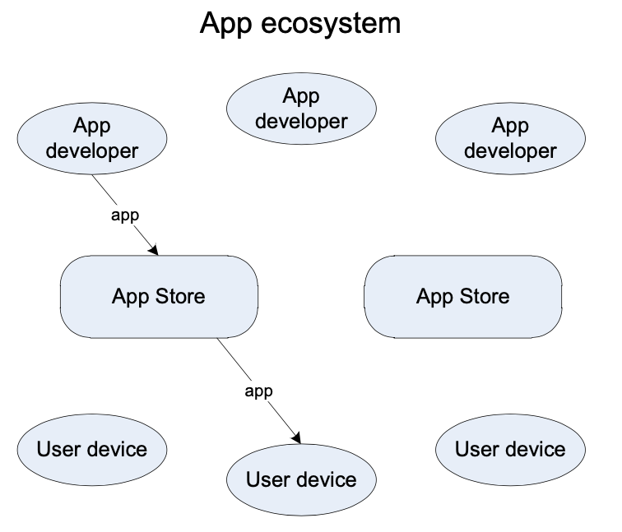
2. App ecosystem
In an app ecosystem, app developers create apps, and sell or distribute them to users

Slide 17
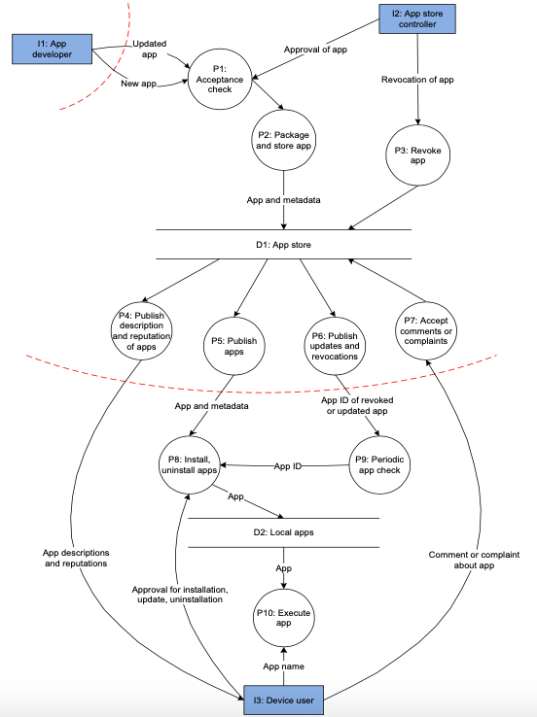
Dataflow diagram of an app ecosystem

Slide 18
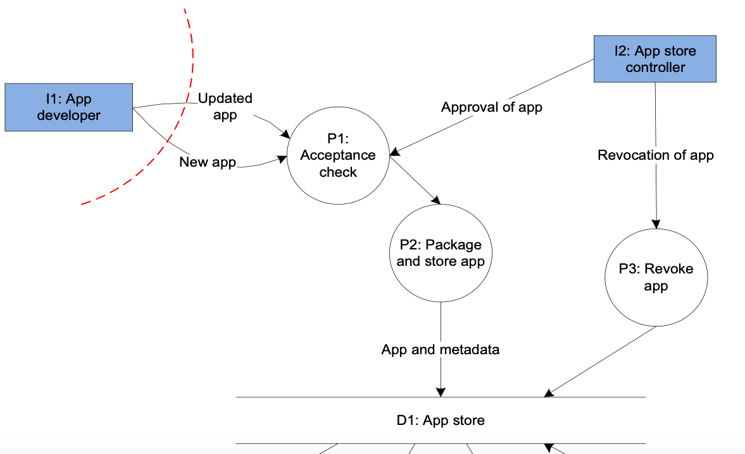

Slide 19
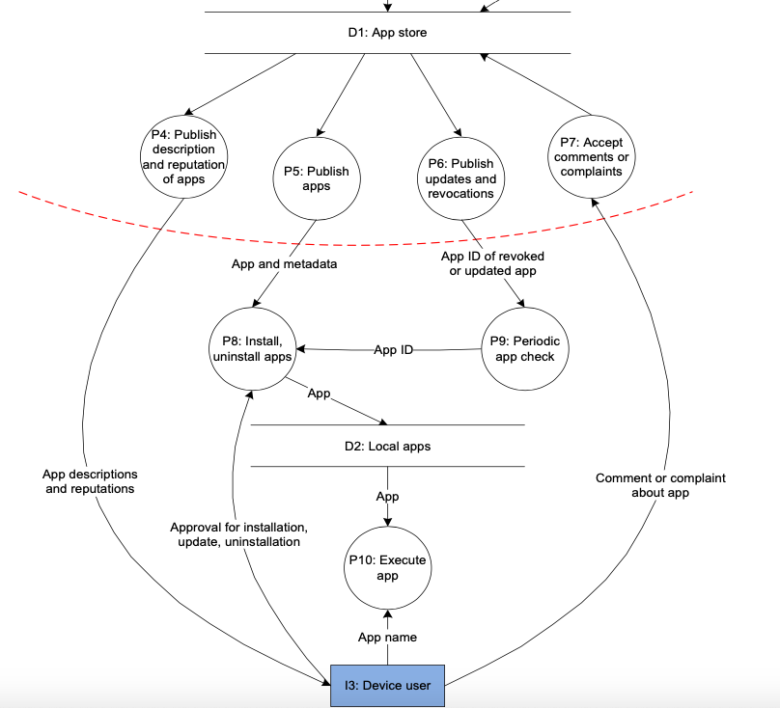

Slide 20
Dataflow diagram of an app ecosystem
The upper left corner shows the main use cases for the app developer (I1). The app developer can send a new app, or an update, to the acceptance check (P1), which checks whether the app is suitable for inclusion in the appstore.
The upper right corner shows the main use cases for the appstore controller (I2). The appstore controller can approve apps for inclusion in the appstore (P1). After approval the app is packaged for inclusion in the appstore (P2).
Metadata is added to the app such as a description and a list of permissions that the app needs on the user device (sometimes called a ‘manifest’). Additionally the appstore controller can revoke bad apps (P3), based on complaints for example. Revocation removes apps from the user devices (sometimes called a ‘kill switch’).

Slide 21
The lower part of the diagram shows the main use cases for the device user (I3). The device user can browse descriptions and reputation of apps (P4). The installer (P8) requires as input the actual app published by the appstore (P5) and approval from the device user. On installation the apps are stored in the datastore with installed apps (D2). After installation the device user can execute an app (P10). The device user can also submit comments and complaints about apps, which are processed and stored in the appstore (P7).
To ensure that the user devices receive timely updates and revocations, there is a periodic check (P9) for updated or revoked apps. Updates and revocations trigger the installer to install an updated app or uninstall a revoked app.

Slide 22
3. STRIDE threat analysis
Attacker model
The attackers have two intermediate technical goals:
· to get malicious code on the user device, and (if that works)
· to keep malicious code on the user device

Slide 23
Attack model
There are 2 layers of software on a smartphone: the OS and the apps. So there are 4 categories of malware attacks:
1. Sell or distribute a malicious app.
2. Exploit vulnerability in an existing app.
3. Sell or distribute a malicious OS
4. Exploit vulnerability in an existing OS

Slide 24
STRIDE categorizes threats into six types
Spoofing threats: a process or an interactor pretends to be someone/thing else.
Tampering threats: a process, a data flow, or a datastore is changed.
Repudiation threats: evidence of an action by a process or an interactor disappears.
Information disclosure threats: a process, a dataflow, or a datastore reveals sensitive data.
Denial of service threats: a data flow, a datastore, or a process is overloaded, rendering normal use impossible.
Elevation of privilege threats: a process is used to perform unauthorized actions.

Slide 25
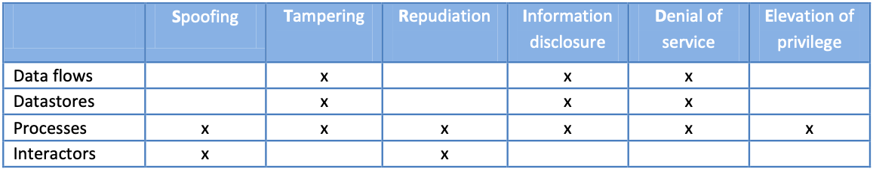
6 threat types apply to different elements in a dataflow model

Slide 26
STRIDE threat analysis
Our model has 3 interactors, 10 processes, 2 datastores, and 20 dataflows
The full STRIDE sweep gives 132 threats.

Slide 27
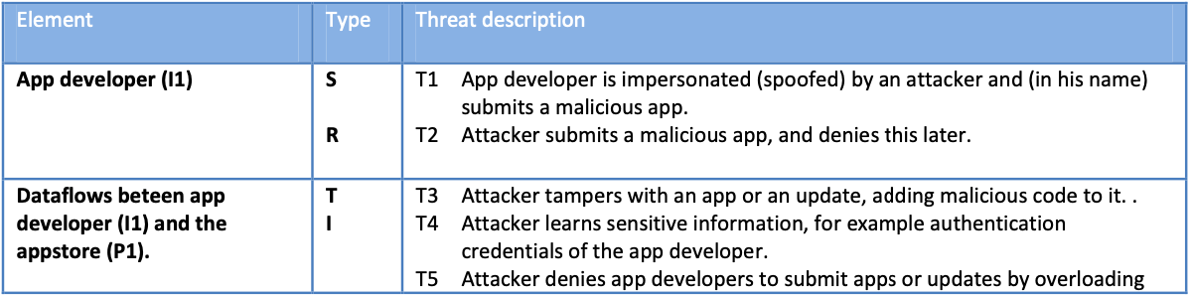
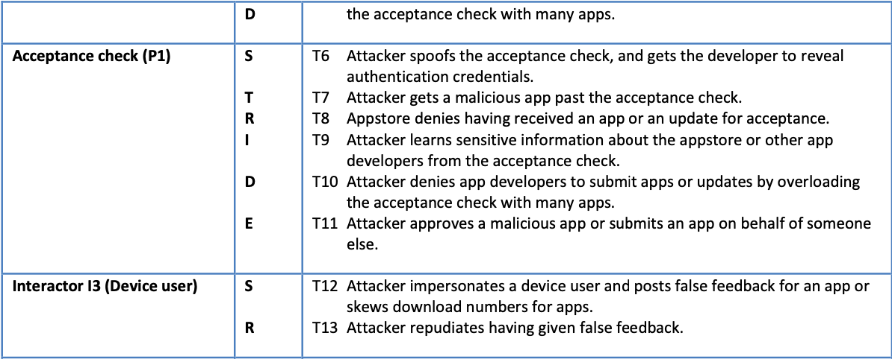

Slide 28
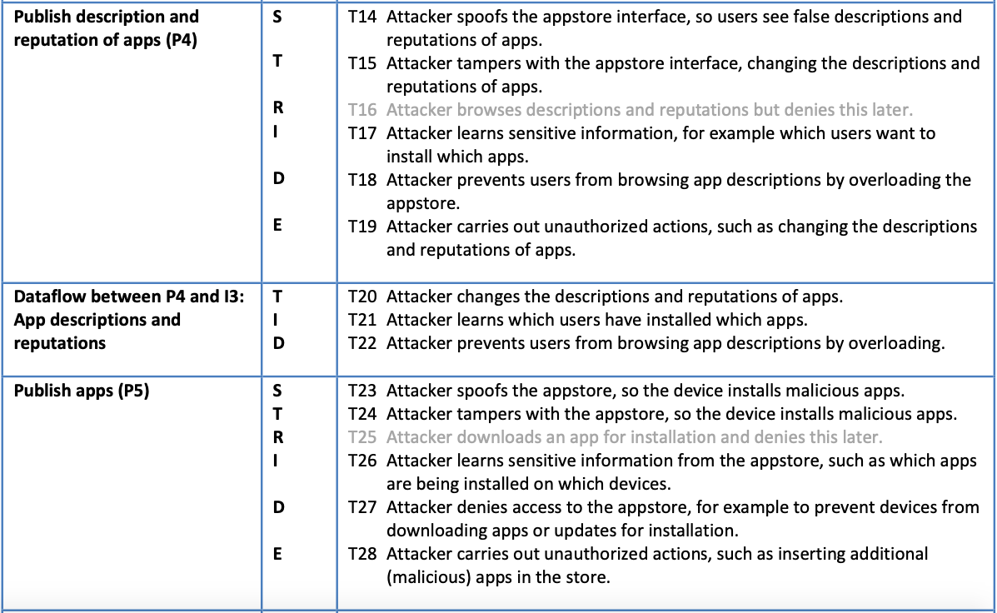

Slide 29
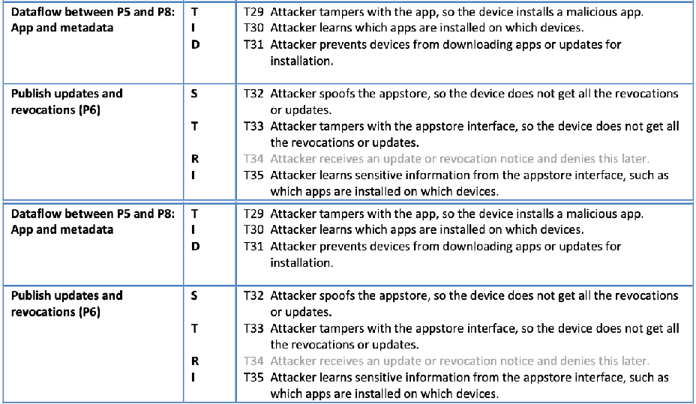

Slide 30
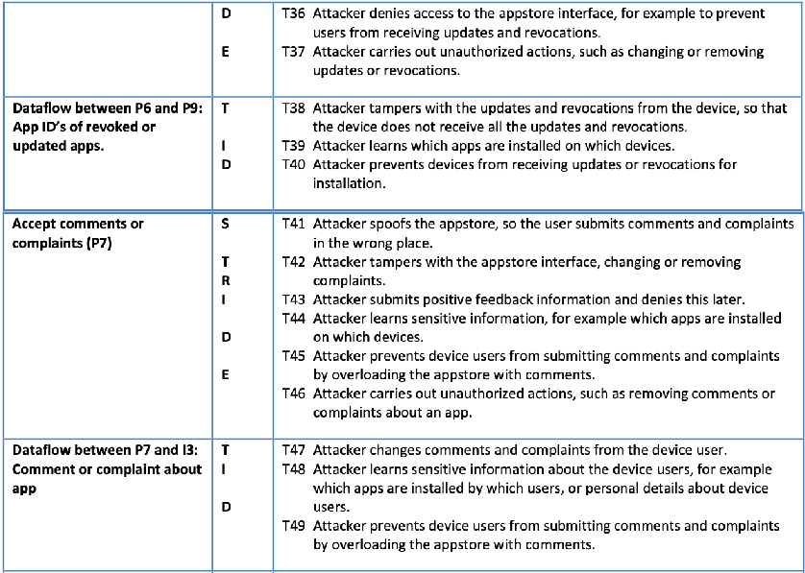

Slide 31
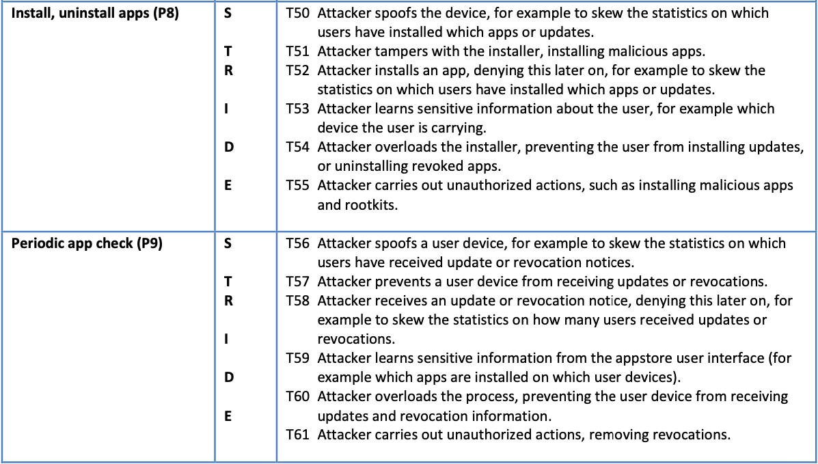

Slide 32
Attack tree
The top nodes are the high-level technical attacker goals: to get malicious code on the user device, and to keep malicious code on the user device.
An arc denotes conjunction (meaning that both sub goals are required to execute the attack).
The threats from the STRIDE analysis, showing how they can be used in attacks, are on the bottom of the diagram

Slide 33
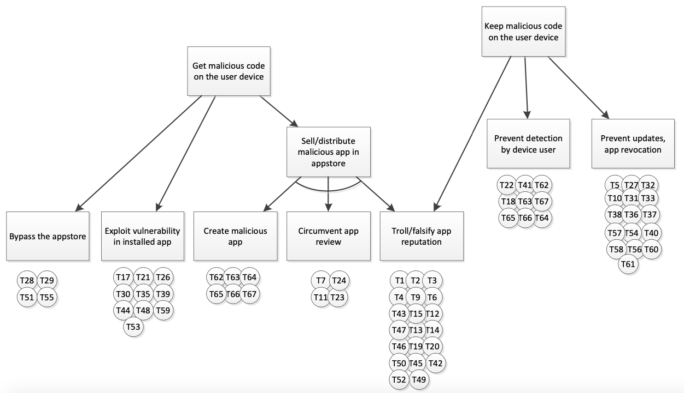

Slide 34
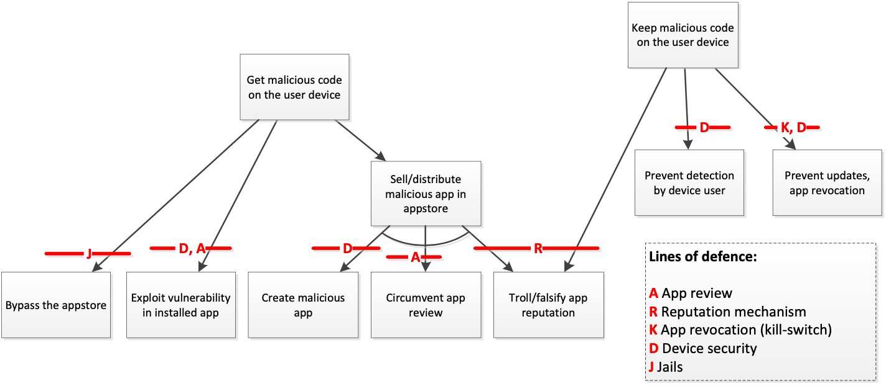
Lines of defence

Slide 35
4. App review
Automated software analysis tools: Static analysis tools can be used to inspect the source or binary code of an app to ensure that it does not use unauthorized functionality and that it adheres to (some of) the developer guidelines.
An example would be the tool in Apple’s submission process that checks for forbidden API calls.
In addition to static analysis tools, dynamic analysis tools can be used, that will actually run the app against a number of test cases so it can be checked and monitored for unwanted or unauthorized behaviour.
An example is Microsoft’s ‘Hopper’ tool that runs a submitted application for a number of hours and monitors memory usage, performance, and stability.

Slide 36
App review
Manual analysis: there are a number of aspects that can only be checked by a human, for example if an app is trying to spoof another app to fool the user. Escalation procedures and a focus on critical functionality can be used to make manual analysis more efficient.
Sharing analysis results: When possible, results of security analysis should be shared with other appstores and security researchers. Appstores could also leverage the expertise of 3rd party researchers and security companies by allowing them to bulk-download and analyse apps.

Slide 37
App review
Authentication of app developers: In app ecosystems often single individuals create apps rather than large software vendors. Apps are not only developed in well-protected development environments.
Risk profiling of app developers: The appstore should monitor and create risk profiles of app developers. New app developers, or app developers who submit unsafe or malicious apps, should be treated with special care

Slide 38
App review
Continuous process: App review should be a continuous process, and appstores should analyse apps even after they have been admitted to the appstore. This type of ex-post review could be triggered by the popularity of an app (download numbers) or the reputation mechanism (see below).
Priority for updates: Appstores should consider priority vetting for updates to existing (and popular) apps to allow app developers to patch vulnerabilities quickly.

Slide 39
5. Reputation mechanism
App track record: an app should show the history and track record of app developers and apps, download statistics of apps, user votes, and detailed comments and complaints from users.
Separate security and privacy reputation: users often only rate apps for their functionality. Security and privacy information about apps should be treated separately in app store reputation mechanisms.
Sybil attack resistance: Mechanisms should be in place to avoid attackers from creating multiple pseudonymous identities and thereby gaining excessive influence to be able to skew the reputation of apps (aka Sybil attack).

Slide 40
Reputation mechanism
Second-order reputation: can prevent attacks on the reputation scheme by giving more weight to votes from users who have a good reputation amongst other users.
Anonymous feedback: Comments and complaints from device users should be anonymised and sensitive information about device users should be removed from public feedback to encourage honest feedback and to avoid targeted attacks that rely on which apps a device user installed.

Slide 41
Reputation mechanism
Exchanging reputation information: When possible, reputation information about the same app in other (trusted) appstores should be taken into account.
Permission feedback: reputation systems should allow users to give separate feedback on specific security-relevant features such as excessive permission requests (e.g. snake game asks for access to GPS and telephone calls).

Slide 42
6. App revocation (kill-switch)
User communication and consent: Removing apps from user devices is a controversial subject. Users should be informed about the reasons for the removal and, if this does not jeopardize other users, given a chance to opt-out.
Spawning: It is important to prevent a malicious app from spawning – installing difficult to remove code – across the user device during installation or runtime. I.e. it should be possible, by uninstalling the app to reverse all changes caused by the app.

Slide 43
App revocation (kill-switch)
Update frequency: Security updates should be kept small in size whenever possible, to prevent that users with limited-bandwidth or metered internet access skip large updates.
Detection: Comments and complaints should be monitored continuously. Apps may exhibit malicious behaviour at a specific moment (say Easter eggs), at random intervals, or randomly across users as seen in malvertisement attacks.
False positives: App revocation could potentially be used to uninstall good apps from user devices. The app revocation mechanism should only be accessible to security teams who can base their decisions on app reviews, user reviews, complaints.

Slide 44
7. Device security
Code signing: The user device should only accept apps that are signed by the right app store.
Sandboxes: The user device should have sandboxes (or containers) for apps, so that apps are installed and run in isolation, to reduce the impact of malware.
Minimal set of privileges: In the sandbox, apps should have only a minimal set of privileges by default (applying the principle of least privilege) and if an app needs additional privileges (for example to access GPS data) this should be handled with care.

Slide 45
7. Device security
Monitoring by the smartphone user: The device should monitor apps after they have been installed. Device users should have the possibility of seeing reports of the activity of an app (network usage, resource usage, and so on) to detect resource-intensive code.
Clean slating: The device should – when triggered by the appstore or the user – uninstall the app and return the device to a pre-install state

Slide 46
8. Jails (or walled gardens)
Closed app ecosystems: there are one or more designated appstores that can sell or distribute apps. The devices are configured in such a way that users can only install apps from one or more designated appstores.
Enterprise app stores: For enterprise users, smartphones could be configured to allow only apps from a dedicated enterprise app store, allowing the enterprise tight control on app installation.
Open app ecosystems: In an open app ecosystem anyone can open an appstore and start selling or distributing apps to device users.

Slide 47
8. Jails (or walled gardens)
Federated appstores: Appstores could form federations by agreeing to a minimum level of security. Such a federation of app ecosystems could give end-users more choice, while at the same time preserving the security benefits of a closed app ecosystem.
App reputation across appstores: to keep a single central list of ‘well-reputed’ apps as the app whitelist of the app ecosystem. Such a reputation system would provide a central repository of security information about apps, independently of where the apps are sold.

Slide 48
9. Sandboxing and capabilities
Sandboxing is a security mechanism for separating running applications by default.
Moreover smartphone operating systems are often based on a capability-based access control model. In this model, individual processes are granted separate privileges (called capabilities) which are limited by default, following the principle of least privilege.

Slide 49
10. Controlled software distribution
By default, users can only add applications from a centrally controlled distribution channel.
On many smartphone platforms, it is unusual for users to install software from other sources and this sometimes requires unlocking (sometimes known as ‘jail-breaking’ or ‘rooting’) the smartphone.
App-store owners have the opportunity to perform a security review of apps before admitting them to the app-store and to remove apps from circulation which are subsequently shown to have security flaws
The walled-garden approach makes it more difficult for cyber attackers to spread malware

Slide 50
11. Remote application removal
It provides the opportunity for vendors to remove malware from users devices even when it is already installed.
Signature revocation could be used with a similar effect

Slide 51
12. Backup and recovery
Some platforms automatically back up contacts, calendar or emails to a remote service.
Smartphone applications, furthermore, often rely on network-based storage and backup.
Smartphones can even be located remotely via the network, allowing the user to recover a lost device more easily. Additionally, some
Smartphones can be disabled and wiped remotely

Slide 52
13. Extra authentication and encryption options
Smartphones may also be used to create one-time-password codes without using SMS or network connections.
The SIM card used in smartphones is a smartcard and, with the appropriate software, licences and certificates in place, can be used for PKI-based authentication and digital signatures

Slide 53
References:
Marnix Dekker, Giles Hogben, Appstore security: 5 lines of defence against malware, ENISA, 2011
Giles Hogben, Marnix Dekker, Ulf Bergstrom, Smartphones: Information security risks, opportunities and recommendations for users, ENISA, 2010
Building Secure Software: How to avoid the Security Problems the Right Way, John Viega, Gary McGraw, Addison-Wesley, 2002
ENISA. Cloud Computing Security Risk Assessment. [Online] 2009.
Reminding: Watch course Introduction to networking for complete beginnershttps://www.udemy.com/course/introduction-to-networking-for-complete-beginners/

